Slide 1
Learning python 20220928

Slide 2
OBJECTIVE
Learning Pythons
Input and Output
Data Type
Operators

Slide 3
Content
What is Python?
Python Jobs
Why to Learn Python
Python Online interpreter
*One
*Two
Google Colab
Python Codes

Slide 4
What is Python?
Python is a very popular general-purpose interpreted, interactive, object-oriented, and high-level programming language. Python is dynamically-typed and garbage-collected programming language. It was created by Guido van Rossum during 1985- 1990. Like Perl, Python source code is also available under the GNU General Public License (GPL).

Slide 5
Python Jobs
Today, Python is very high in demand and all the major companies are looking for great Python Programmers to develop websites, software components, and applications or to work with Data Science, AI, and ML technologies. When we are developing this tutorial in 2022, there is a high shortage of Python Programmers where as market demands more number of Python Programmers due to it's application in Machine Learning, Artificial Intelligence etc.

Slide 6
Why to Learn Python
Python is consistently rated as one of the world's most popular programming languages. Python is fairly easy to learn, so if you are starting to learn any programming language then Python could be your great choice. Today various Schools, Colleges and Universities are teaching Python as their primary programming language. There are many other good reasons which makes Python as the top choice of any programmer.

Slide 7
Why to Learn Python 3 Top Reasons to Learn Python
Learning Python will Improve Your Job Prospects.
Python is the Easiest Programming Language to Learn.
You can Earn a Competitive Salary Working as a Python Developer.

Slide 8
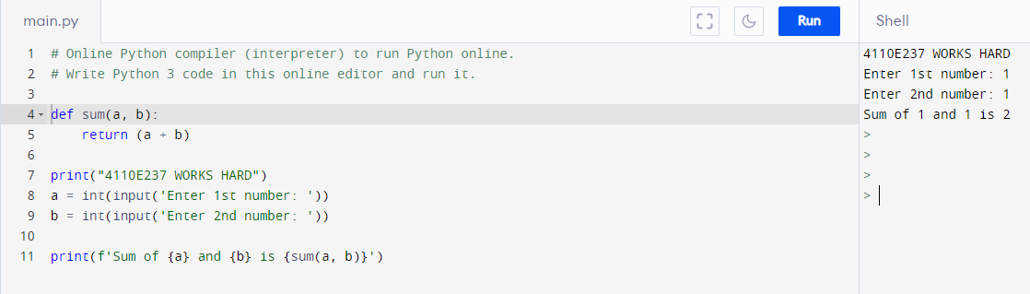
Python Online Interpreter #1

Slide 9
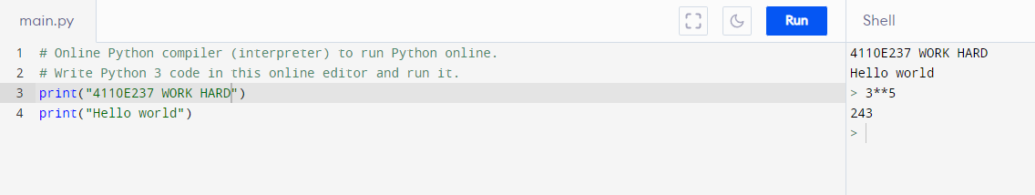
Python Online Interpreter #2
INTERACTIVE

Slide 10
INPUT AND OUTPUT
20220928

Slide 11
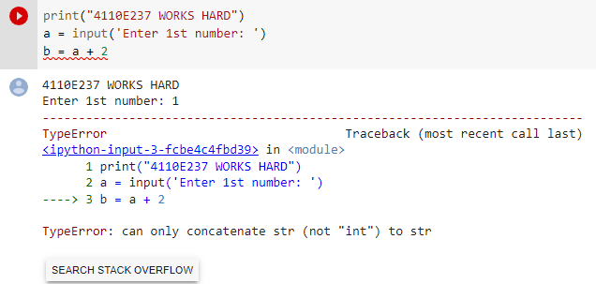
QUESTION:
DATA TYPE

Slide 12
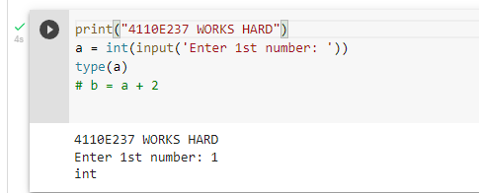
WAY: 1

Slide 13
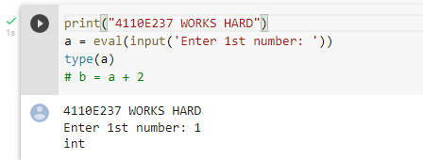
WAY: 2

Slide 14
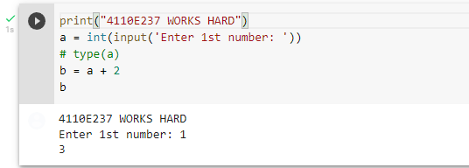
ANSWER: 1

Slide 15
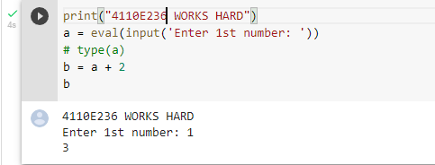
ANSWER: 2

Slide 16
PYTHON DATA TYPE
20220928

Slide 17
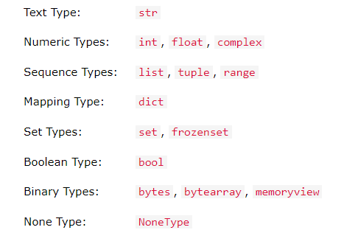
In programming, data type is an important concept.
Variables can store data of different types, and different types can do different things.
Python has the following data types built-in by default, in these categories:

Slide 18
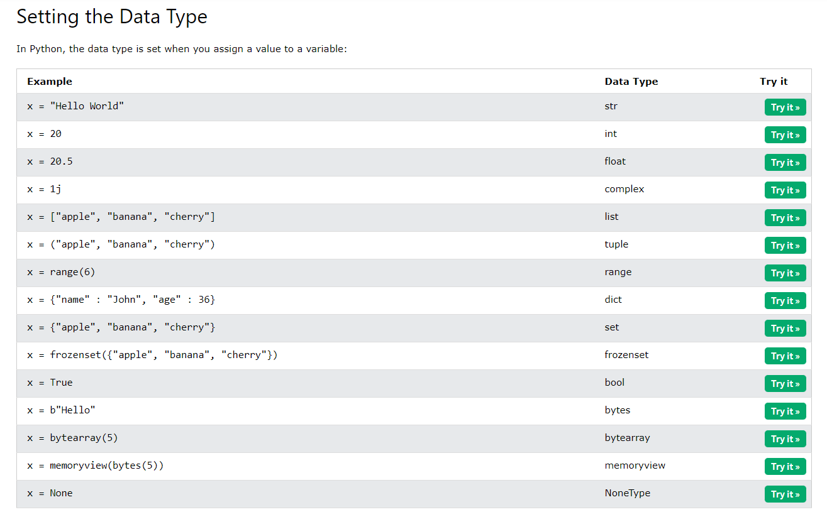
SETTING THE SPECIFIC DATA TYPE

Slide 19
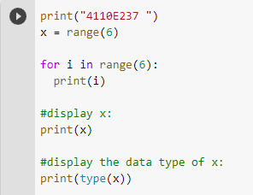
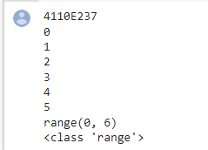
PYTHON DATA

Slide 20
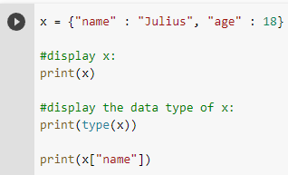

DICT: KEY VALUE PAIR

Slide 21
PYHTON OPERATORS
20220928

Slide 22
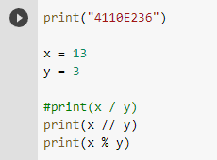

PYTHON ARITHMETIC OPERATORS

Slide 23
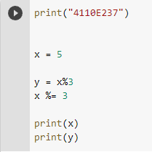

PYTHON ASSIGNMENT OPERATORS

Slide 24
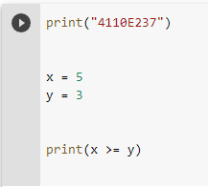

PYTHON COMPARISON OPERATORS

Slide 25
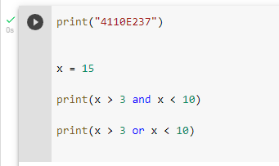

PYTHON LOGICAL OPERATORS

Slide 26
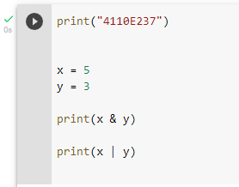

PYTHON BITEWISE OPERATORS

Slide 27
THANK YOU
CHINESE NAME:柯保羅
STUDENT ID:4110E237
ENGLISH NAME: Saflor, Julius Erick Dela Cuesta
NICKNAME: 0001Player
Email: juliusericksaflor@gmail.com
GITHU: https://github.com/0001Player/cs2022

